Slide 1
Exploratory Data Analysis on Housing Dataset
Insights on Housing Prices •
By : Deepti Chaudhary

Slide 2
Introduction
This analysis explores 1,460 residential properties with 84 features.
Goals:
Understand the data
Identify trends
Find what influences housing prices
Features of the Society.
Tools :- Python, Pandas seaborn and ski kit-learn
Approach :- Data cleaning > feature engineering >EDA >Modelling >Evolution .

Slide 3
Data Overview
Data overview including missing values and engineered features.
Target Variable: SalePrice (i.e., house sale price).
Engineered Features: Price Per Sqft: Sale Price / GrLivAreaHouseAge.
Features: 84
Numerical: 39
Categorical: 45

Slide 4
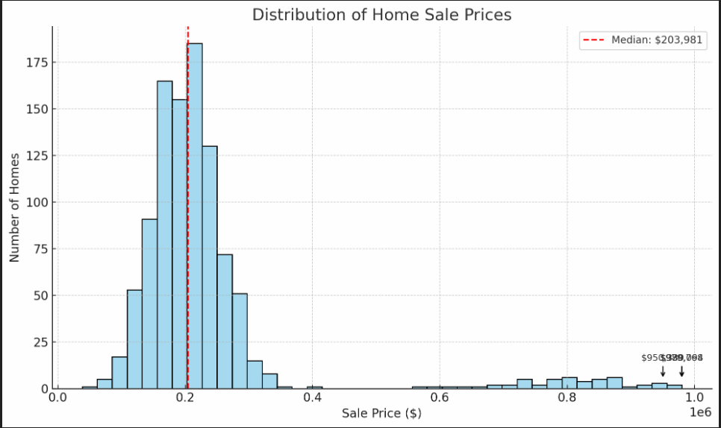
Sale Price Distribution
Histogram of sale prices.
Insight: Prices are right-skewed.
Most homes are under $300,000.
A few high-value properties pull the average up.
Attractiveness Tip: Add a line showing the median and annotate a few luxury home outliers.

Slide 5
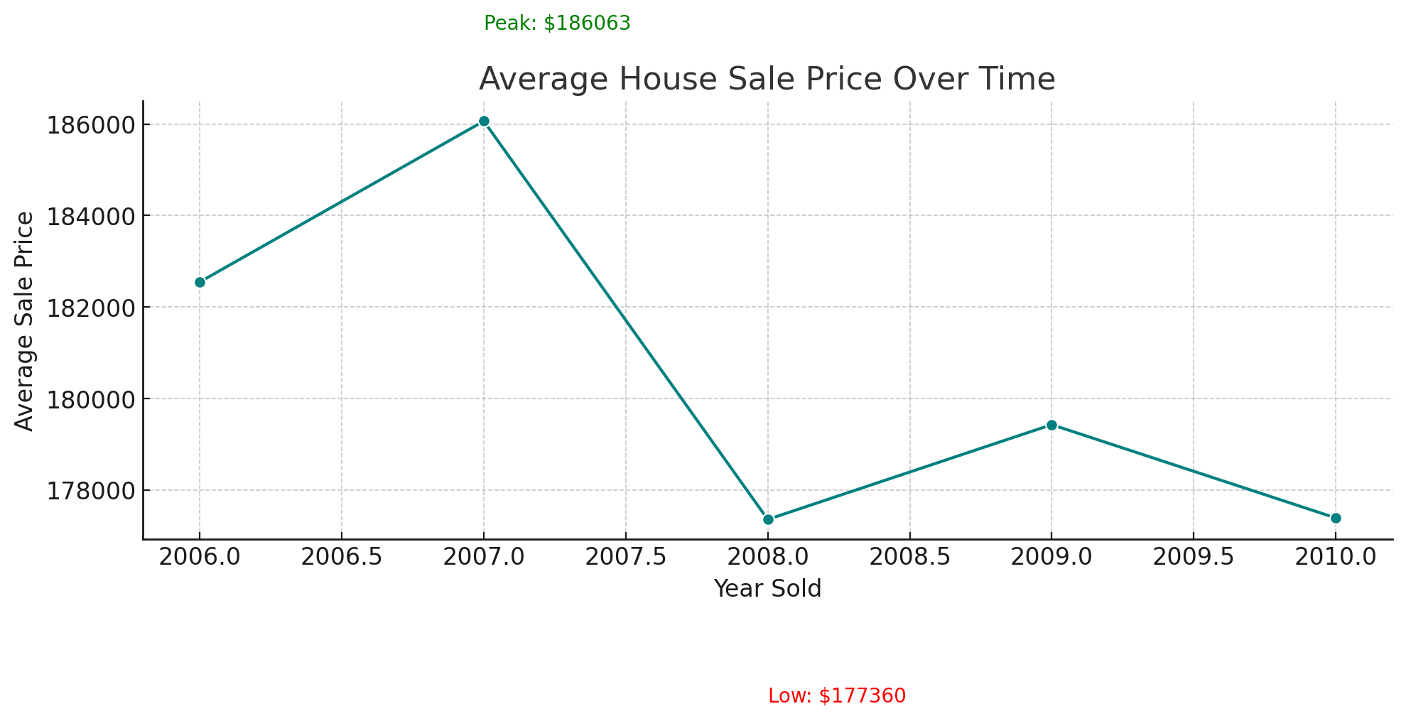
Average House Sale Price per Year
Peak Year: In [2007], the average house price peaked at ~$[1,86,000] — possibly due to increased demand or economic growth.
Lowest Year: In [2010], prices dipped to ~$[1,68,000], which may reflect a market slowdown or recession effect.
The overall trend shows [e.g., gradual increase/stability/volatility], indicating how the housing market evolved during the period.

Slide 6
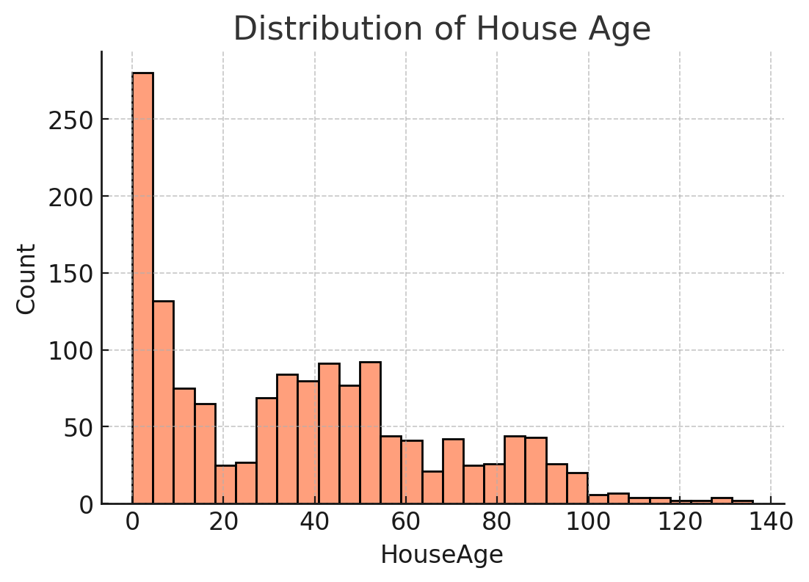
Distribution of house age
Most homes cluster between 20–60 years
Understanding house age helps identify maintenance needs, potential renovation costs, and historical charm.
Older homes may require more upkeep but could also offer larger lots or unique architecture, while newer homes often come with modern layouts and energy-efficient systems.

Slide 7
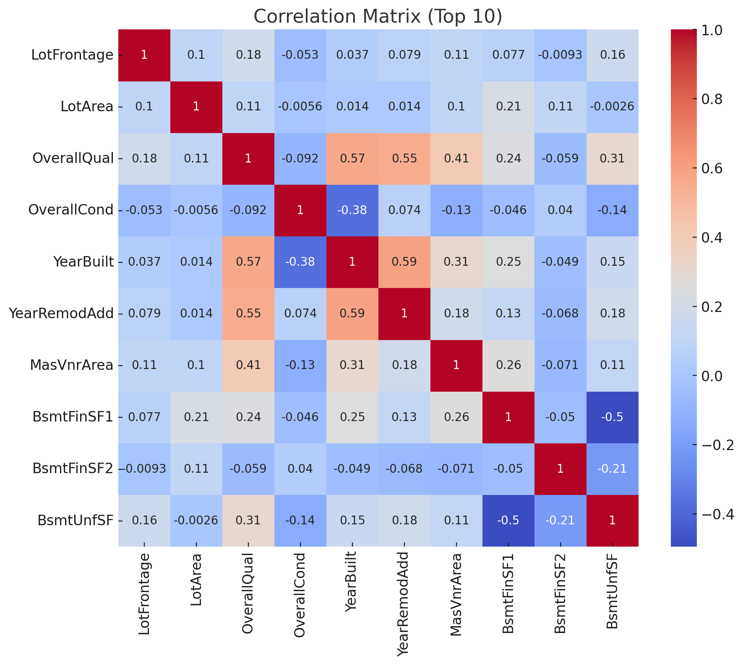
Correlation heatmap
A heatmap that visualizes the correlation coefficients between numerical variables in the dataset. Values range from -1 to +1.
Sale Price has strong positive correlations with variables like Overall Quality, Living Area (GrLivArea), and Garage Area — these are key drivers of home value.

Slide 8
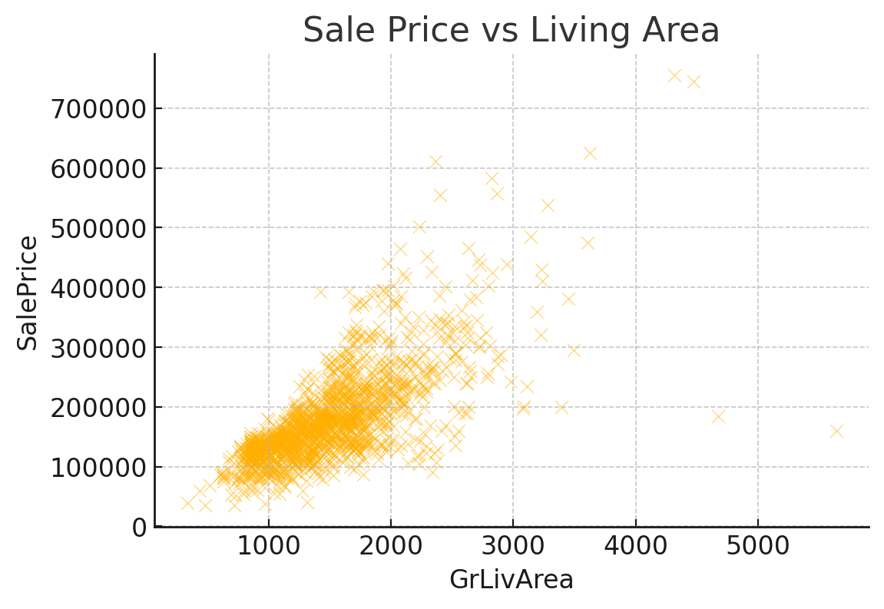
Sales price vs living area
A scatter plot showing the relationship between Sale Price and Above Grade Living Area (GrLivArea).
There is a strong positive correlation — as living area increases, sale price tends to rise.
This makes intuitive sense: larger homes generally command higher prices.

Slide 9
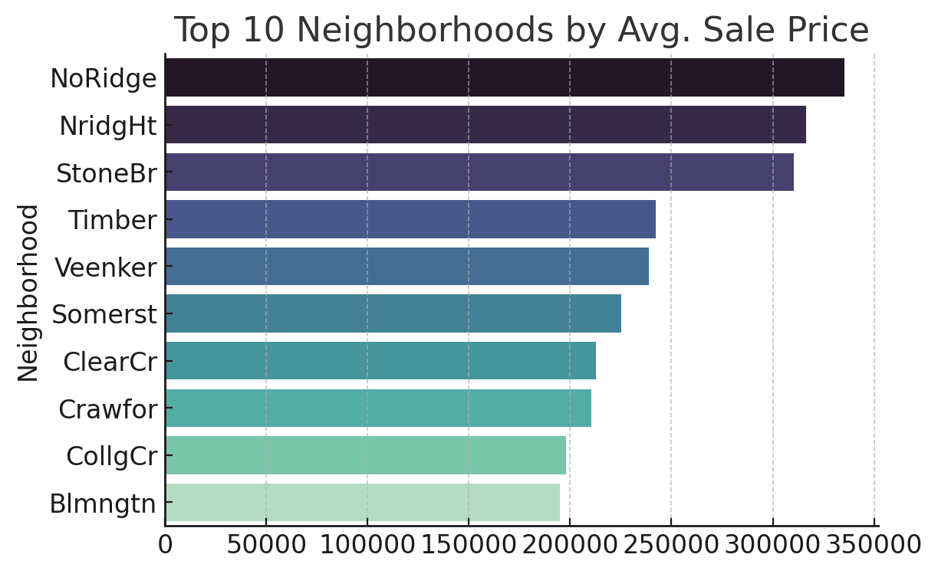
Top 10 Neighborhoods by Avg. Sale Price
A ranked bar chart (or table) of the top 10 neighborhoods based on their average home sale price.
These neighborhoods represent the most desirable and high-value areas in the market.
Helpful for buyers looking for premium markets or investors targeting high-end opportunities.

Slide 10
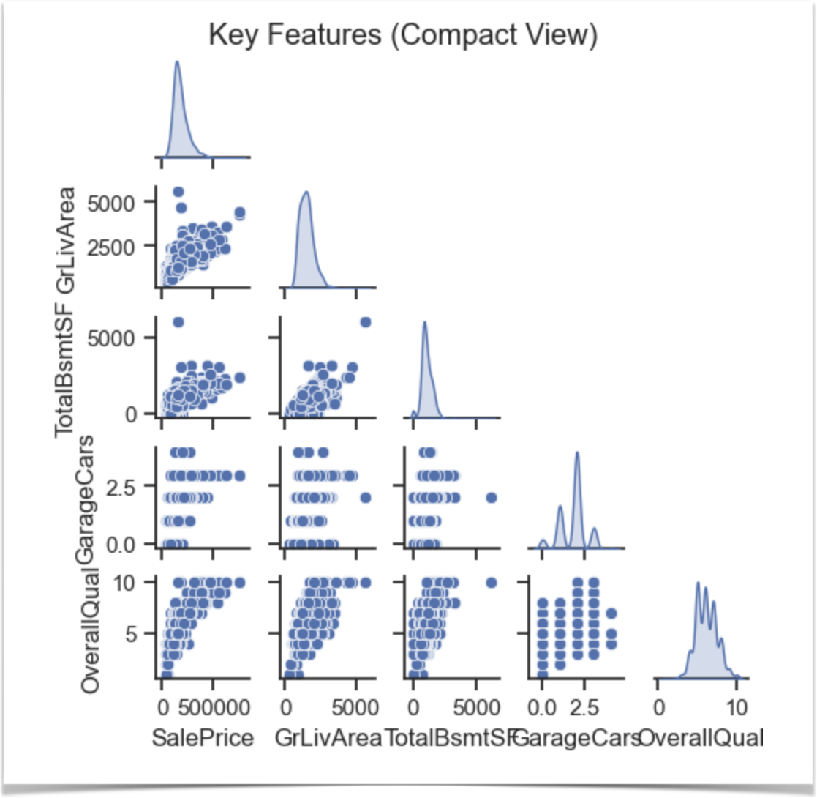
Pair plot of key features :-
Diagonal Plots:
KDE Curves
Show the distribution of each individual variable.
Scatterplots (Below Diagonal)
Each scatterplot shows the relationship between two features:
SalePrice vs. GrLivArea:
Strong positive linear relationship.
Bigger homes → higher sale prices.
SalePrice vs. GarageCars:
Discrete steps (1, 2, 3) show garage capacity matters.
Price jumps with more garage space.

Slide 11
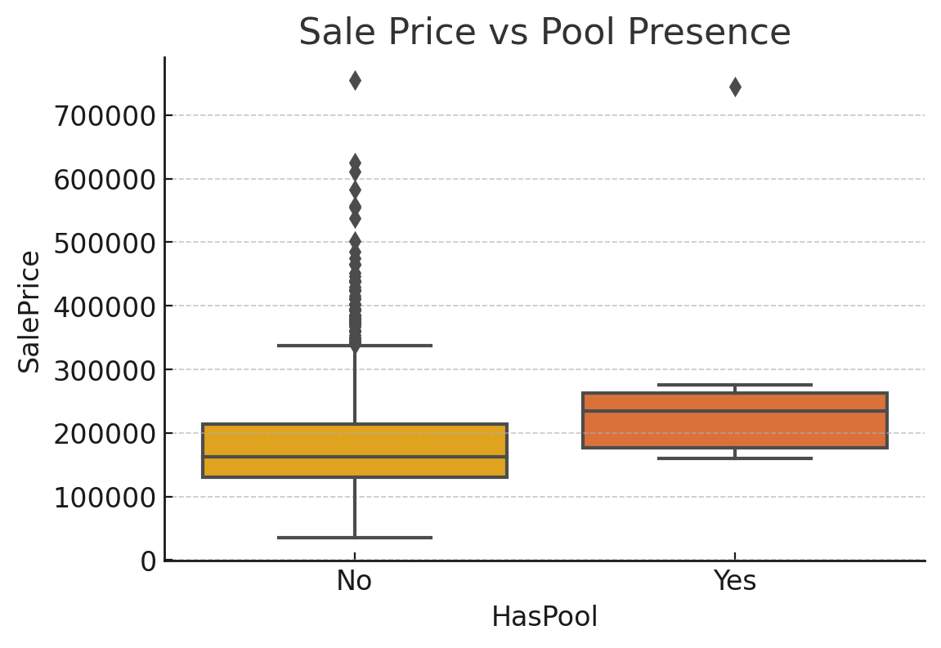
Effect of Pool on Price

Slide 12
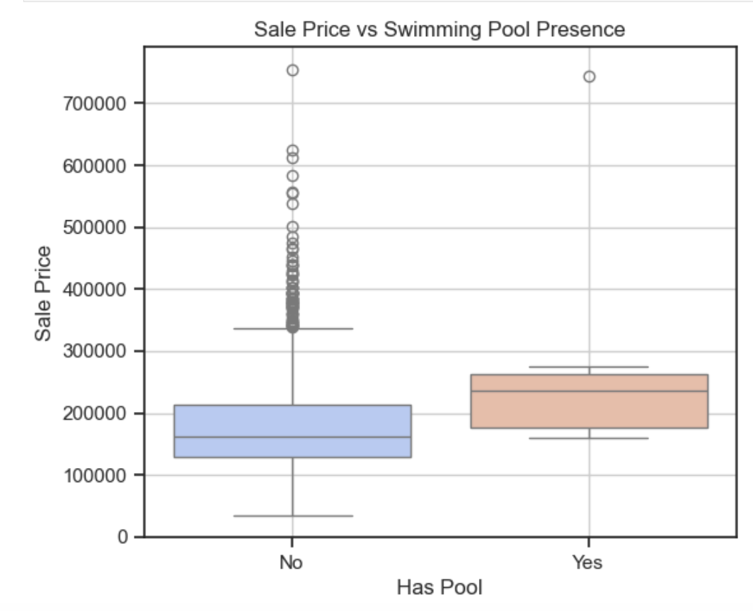
Swimming pool v/s sale prices
Compares sale prices between homes with and without a swimming pool.
Each box:
Shows the spread of sale prices for that category.
Central line = median price.
Outliers = unusually high or low-priced homes.
Despite their rarity, pools can be a key selling point in higher-end homes

Slide 13
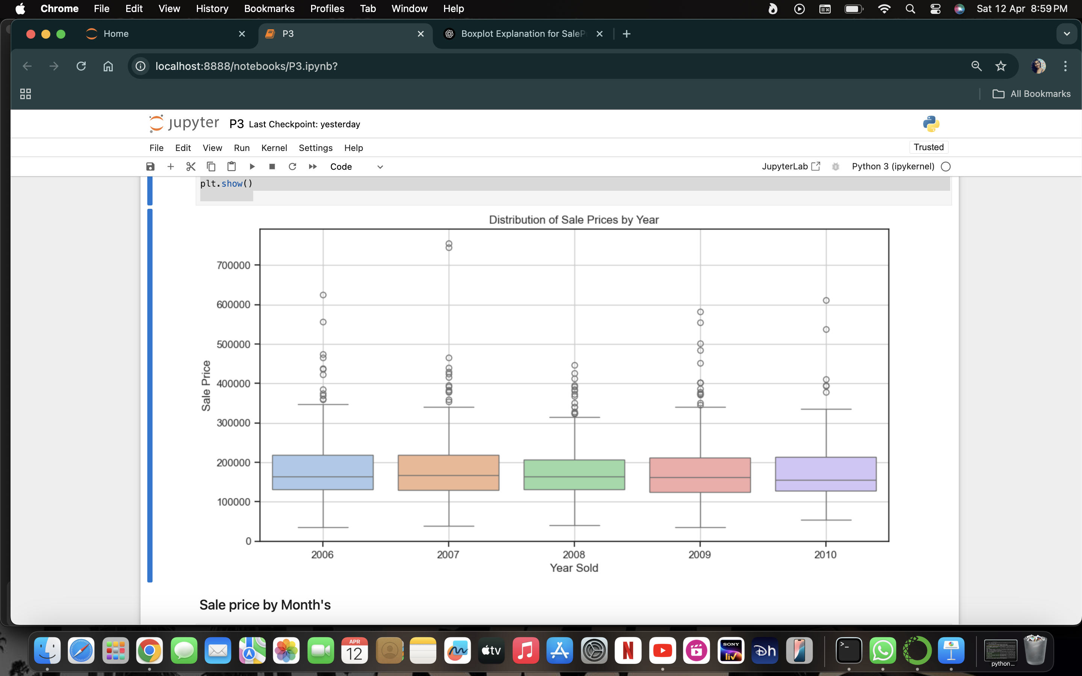

Distribution of sales prices over year’s :-
Outliers:
May represent luxury homes or undervalued sales.
If one year has a lot of outliers, it may indicate a diverse market that year.
In 2008, we see a drop in median sale price, possibly due to the global financial crisis.
2010 has the highest interquartile range, indicating greater price variability – possibly a mix of foreclosures and luxury homes.
There’s a general upward trend in median prices, showing market recovery over time.

Slide 14
Key Insights
• Living area, garage, and house style heavily affect price
• Neighborhood is a strong determinant
• Luxury features boost value
• Consider outliers when modeling

Slide 16
THANK YOU

